Slide 1


Microprocessor Architecture and Internet of Things
Course Code: CET3014B Credits: 3 TH+2 Lab=5

Slide 2
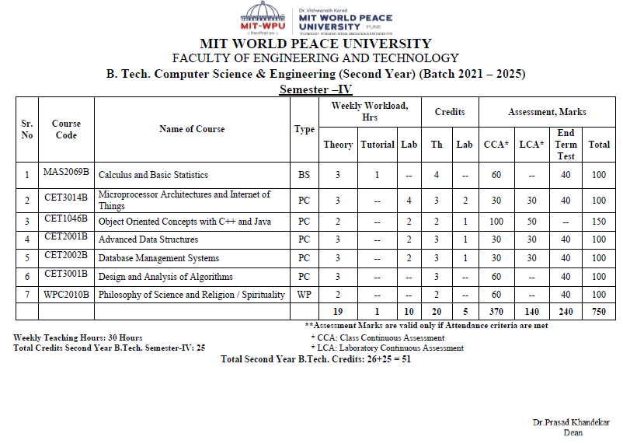
Course Structure - SY

Slide 3
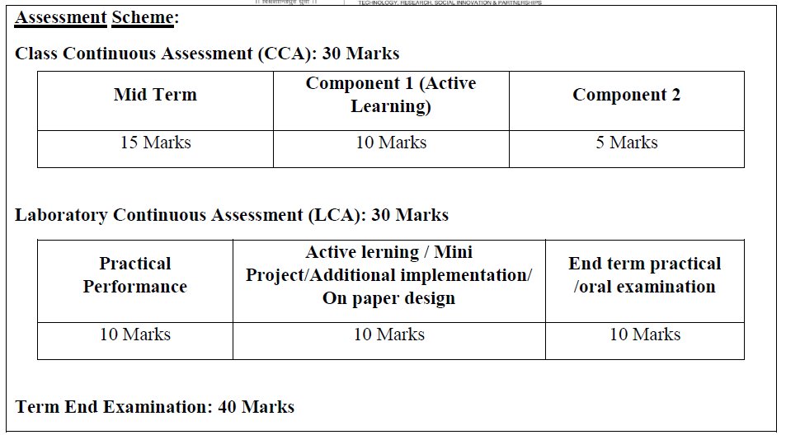
CCA LCA

Slide 4
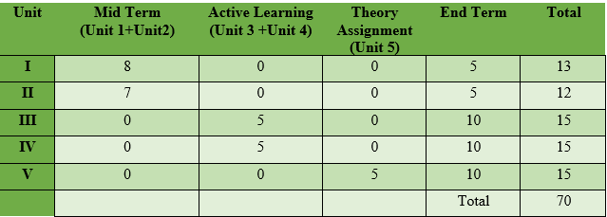
Unit wise distribution of CCA-70 Marks
LCA-30 Marks

Slide 5
Syllabus
Module I: Overview of Embedded System and IoT
Module II: Pentium Architecture:
Embedded Systems: Architecture & Characteristics of ES, Types of Embedded systems, Examples of Embedded Systems. Introduction of IoT: Definition and characteristics of IoT, Technical Building blocks of IoT, Device, Communication Technologies, Data, Physical design of IoT, IoT enabling technologies, IoT Issues and Challenges- Planning, Costs and Quality, Security and Privacy, Risks. Example: Smart Home /Smart Agricultural.
Pentium features, Pentium superscalar architecture - Pipelining, Branch prediction, and Instruction and Data caches. The Floating-Point Unit: features, pipeline stages & data types. Pentium programmer's model, register set, System registers, addressing modes and Instruction set.

Slide 6
Syllabus
Module III:Pentium operating modes:
Pentium Modes of Operation, Pentium Real address mode: Memory organization, Memory segments, segment registers, logical to physical address generation
Protected mode: Segmentation unit support registers, related instructions, segment Memory descriptors, logical to linear address translations.
Module IV:Paging and Protection:
Paging Unit: support registers, related data structures, linear to physical address translation, TLB Protection by segmentation, privilege-levels, rules of inter-privilege level transfer for data and code segments, page level protection.

Slide 7
Syllabus
Unit 5: Pentium Task Management and Interrupt handling:
Task Management, support registers, related data structures, Task switching. Interrupt and Exception Overview, Sources of Interrupts & exceptions, Exception and Interrupt Vectors, Interrupt Descriptor Table (IDT), IDT Descriptors, Exception- or Interrupt-Handler Procedures

Slide 8
Learning Resources:
Text Books:
1. The Internet of Things by Hakima Chaouchi Publishers: ISTE and Willey
2. James Antonakos, “The Pentium Microprocessor”, 2004, Pearson Education ISBN – 81-7808-545-3.
Reference Books:
1. Beginning Arduino by Micheal McRoberts Publishers: Technology in Action
2. IoT Fundamental by Devid Hanes Publishers: CISCO
3. Raspberry Pi Cookbook for Python Programmers by Tim Cox Publishers: PACKT
4. The Official Raspberry Pi Project Book
5. Beginning Sensor Networks with Arduino and Raspberry Pi by Charles Bell Publishers: Technology in Action
6. Intel architecture software developer's manual volume 3.
7. Intel architecture software developer's manual volume 1.
8. Intel 64 and IA-32 Architecture’s software developer's manual

Slide 9
Course Objectives:
By participating in and understanding all facets of this Course a student will be able:
1. Knowledge:
i. To understand the components and techniques used in IoT development environment
ii. To apply the knowledge of fundamentals in IoT for various applications.
iii. To acquire the knowledge of the Pentium processor architectural features, programmer’s model, system registers.
2. Skill:
i. To learn Pentium addressing modes and instruction set for the development of x86/64-bit assembly language programs.
3. Attitude:
i. To describe the role of Memory Management Unit and Privilege levels in protected mode of Pentium processor.
ii. To learn the role of CPU in handling multitasking and processing of interrupts and exceptions in Pentium environment.

Slide 10
Course Outcomes:
By the end of the course, students will be able to
1. Describe the details of IoT based systems.
2. Demonstrate the use of common IoT platforms and installations.
3. Discuss Pentium architecture and programmer’s model.
4. Apply the Assembly Language Programming skills of Pentium processor.
5. Interpret the demand paging and protection mechanism supported in Pentium Architecture.
6. Demonstrate the concept of Task management and Interrupt handling within the Pentium processor.

Slide 11
Unit 1: Overview of Embedded System and IoT
Architecture & Characteristics of Embedded System, Types of Embedded systems, Examples of Embedded Systems.
Introduction of IoT: Definition and Characteristics of IoT, Technical Building blocks of IoT Device, Communication Technologies, Data, Physical design of IoT, IoT enabling technologies, IoT Issues and Challenges- Planning, Costs and Quality, Security and Privacy, Risks. Example: Smart Home /Smart Agricultural.

Slide 12

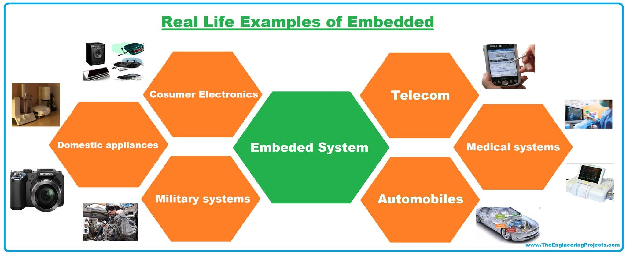
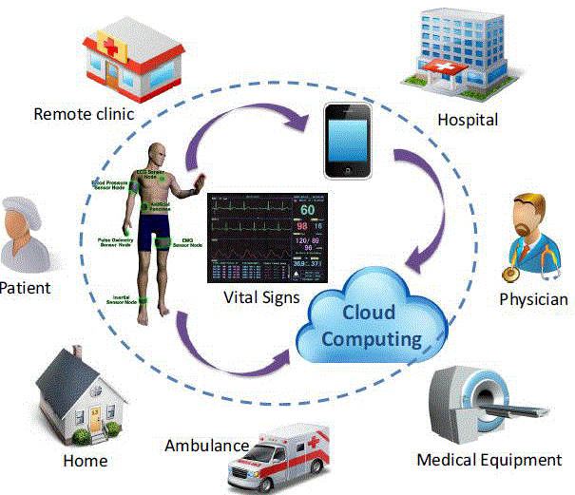
Embedded Systems and IoT

Slide 13
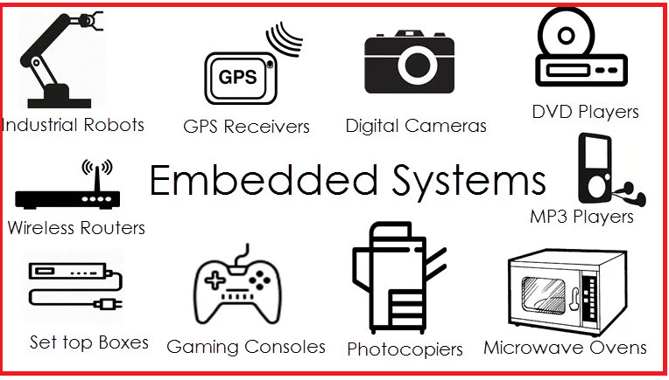
Embedded Systems
What is a system?
A system is a way of working, organizing or doing one or many tasks according to a fixed plan, program or set of rules.
A system is also an arrangement in which all its units assemble and work together according to the plan or program.
What is Embedded System?
An Embedded System is one that has computer hardware with software embedded in it as one of its important components.

Slide 14
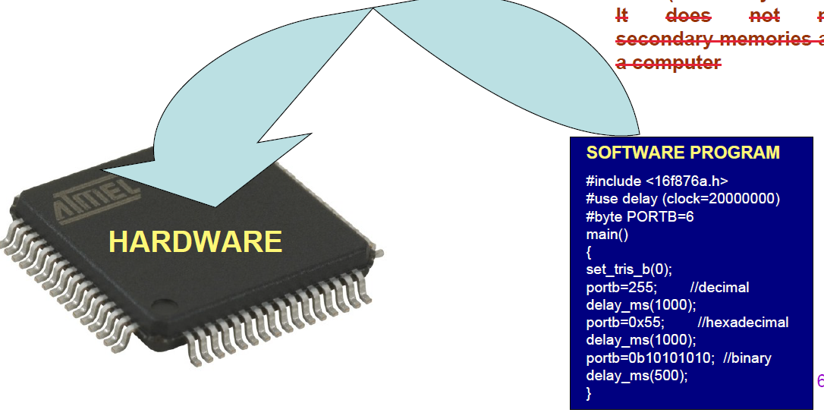
Embedded Systems
Its software embeds in ROM (Read Only Memory). It does not need secondary memories as in a computer.

Slide 15
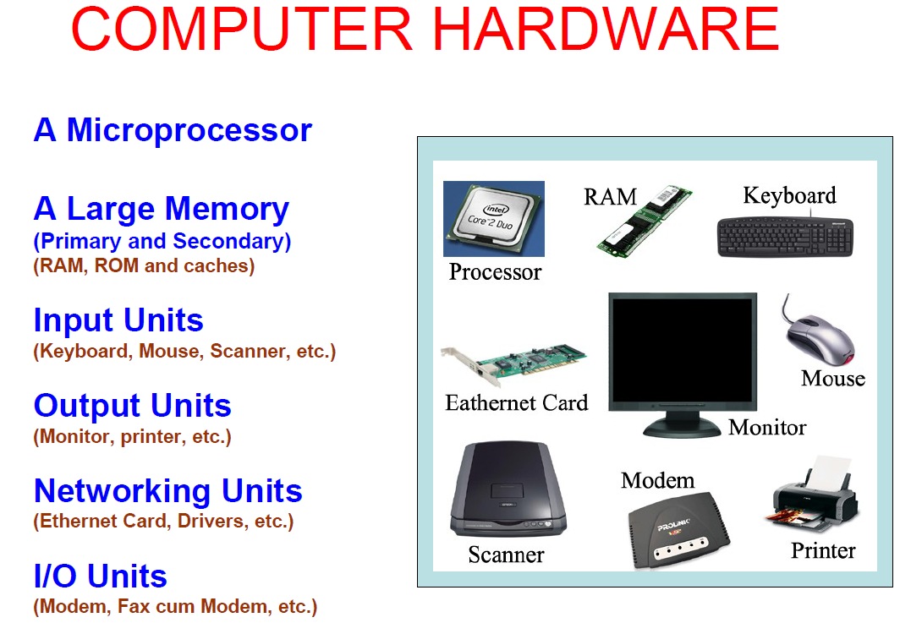
Components of Computer System

Slide 16
Components of Embedded System
It has Hardware----
Processor, Timers, Interrupt controller, I/O Devices, Memories, Ports,
etc.
It has main Application Software------
Which may perform concurrently the series of tasks or multiple tasks.
It has Real Time Operating System (RTOS)
RTOS defines the way the system work. Which supervise the application software. It sets the rules during the execution of the application program. A small scale embedded system may not need an RTOS.
Below are some examples of the real-time operating system, such as:
The operating system of the Microwave oven.
The operating system of the Washing machine.
The operating system of the Aeroplane.

Slide 17
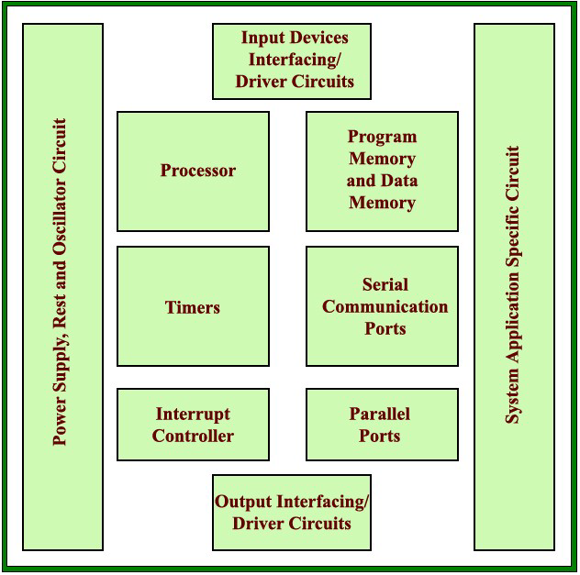
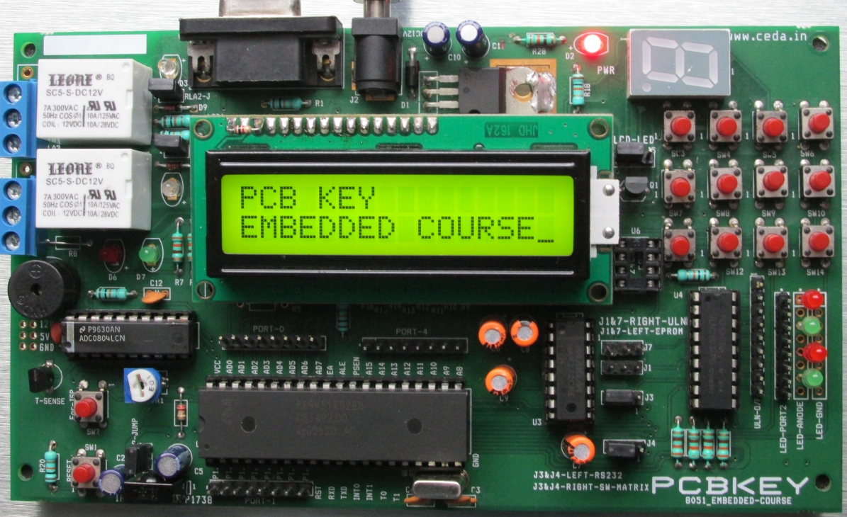
EMBEDDED SYSTEM HARDWARE

Slide 18
EMBEDDED SYSTEM CONSTRAINTS
An embedded system is software designed to keep in view three constraints:
– Available System Memory
– Available processor speed
– The need to limit the power dissipation
When running the system continuously in cycles of wait for events, run, stop and wake up.

Slide 19
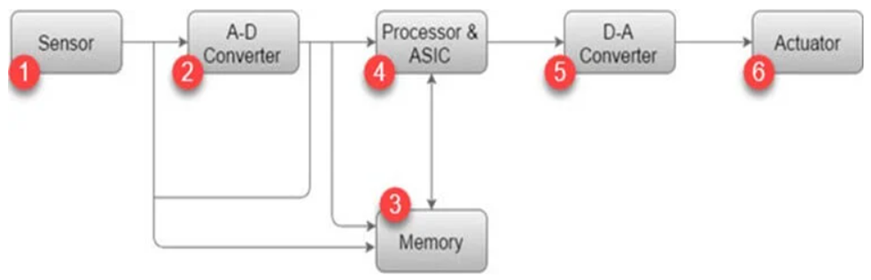
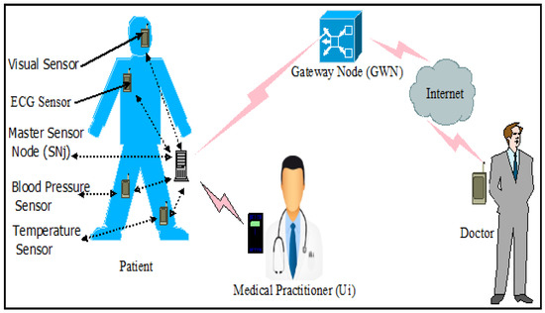
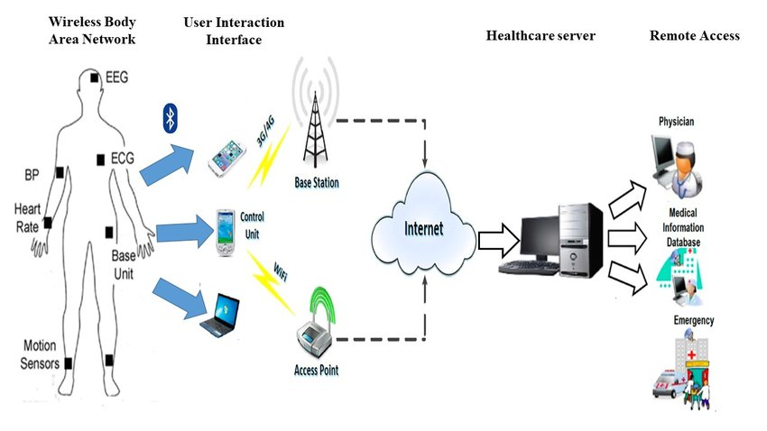
Architecture of Embedded System

Slide 20
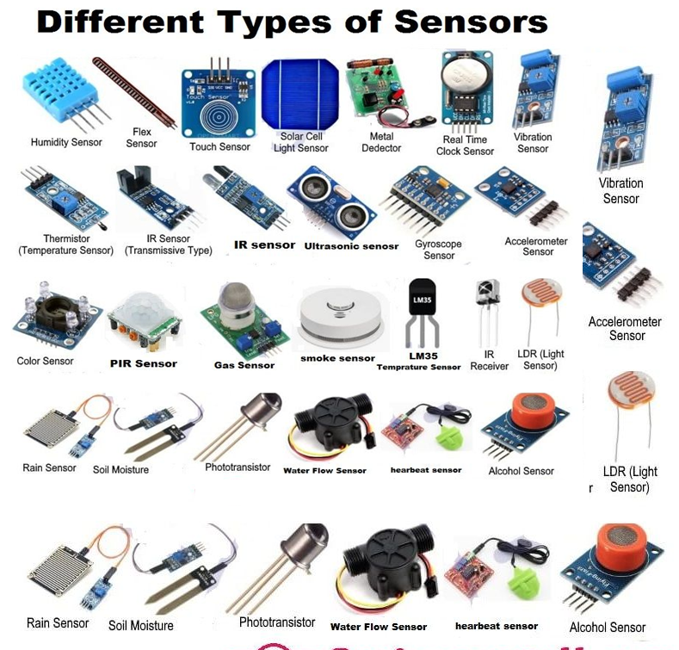
Architecture of Embedded System
1) Sensor:
Sensor helps you to measures the physical quantity and converts it to an electrical signal. It also stores the measured quantity to the memory. This signal can be ready by an observer or by any electronic instrument such as A2D converter.

Slide 21
Architecture of Embedded System
2) A-D Converter:
A-D converter (analog-to-digital converter) allows you to convert an analog signal sent by the sensor into a digital signal.
3) Memory:
Memory is used to store information. Embedded System majorly contains two memory cells 1) Volatile 2) Non volatile memory.

Slide 22
Architecture of Embedded System
4) Processor & ASICs:
This component processes the data to measure the output and store it to the memory.
5) D-A Converter:
D-A converter (A digital-to-analog converter) helps you to convert the digital data fed by the processor to analog data.

Slide 23

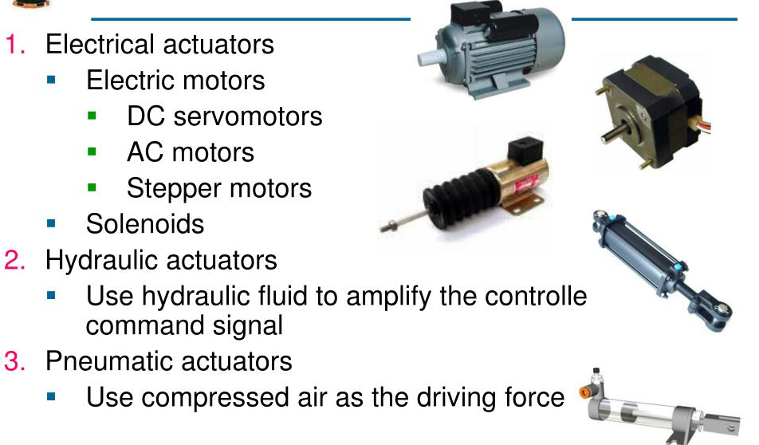
Architecture of Embedded System
6) Actuator:
An actuator allows you to compare the output given by the D-A converter to the actual output stored in it and stores the approved output in the memory.

Slide 24
Types of Embedded System
Types of Embedded Systems
Based on performance and functional requirements
Stand-alone Embedded Systems
Real-time Embedded Systems
Network Embedded Systems
Mobile Embedded Systems
Based on Microcontrollers used:
Small Scale Embedded Systems
Medium Scale Embedded Systems
Large Scale Embedded Systems

Slide 25
Types of Embedded System
Stand Alone Embedded Systems :
Stand Alone Embedded Systems are independent systems which can work by themselves as they don’t depend on a host system.
It takes input in digital or analog form and provides the output.
Examples :
MP3 players
Microwave ovens
calculator

Slide 26
Types of Embedded System
Soft Real Time Embedded Systems –
In these types of embedded systems time/deadline is not so strictly followed.
If deadline of the task is passed (means the system didn’t give result in the defined time) still result or output is accepted.
Hard Real-Time Embedded Systems –
In these types of embedded systems time/deadline of task is strictly followed.
Task must be completed in between time frame (defined time interval) otherwise result/output may not be accepted.
Examples :
Traffic control system, Military usage in defense sector, Medical usage in health sector

Slide 27
Types of Embedded System
Networked Embedded Systems :
Networked Embedded Systems are connected to a network which may be wired or wireless to provide output to the attached device.
They communicate with embedded web server through network.
Examples :
Home security systems
ATM machine
Card swipe machine

Slide 28
Types of Embedded System
Mobile Embedded Systems :
Mobile embedded systems are small and easy to use and requires less resources.
They are the most preferred embedded systems.
In portability point of view mobile embedded systems are also best.
Examples :
MP3 player
Mobile phones
Digital Camera

Slide 29
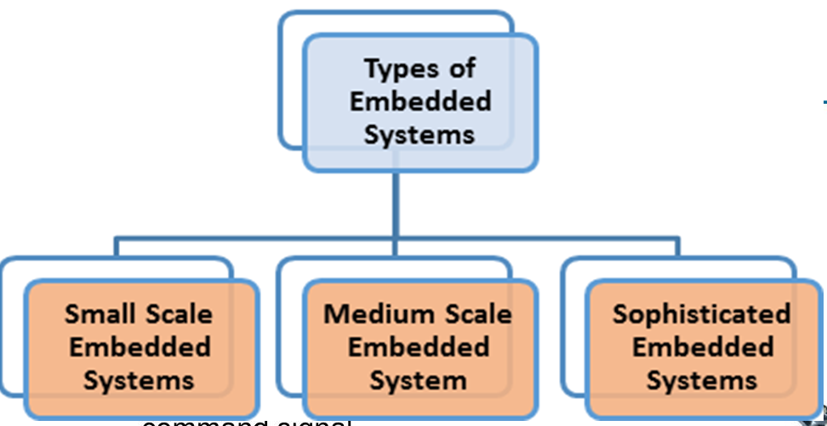
Types of Embedded System

Slide 30
Types of Embedded System
1. Small scale embedded system:
An entry level 8/16 bit processor system.
The processor has very limited resources like ROM, RAM, and processing speed.
They can be powered by a battery.
Mainly these systems does not act as an independent system they act as any component of computer system but they did not compute and dedicated for a specific task.
Examples: CD Drive, printer, automatic door lock

Slide 31
Types of Embedded System
Medium scale embedded systems:
This embedded system consists of 16/32 bit microprocessors. These are usually faster than “small scale systems” due to greater number of bits, that provide a higher speed.
Integration of hardware and software is complex in these systems.
Java, C and C++ are the programming languages are used to develop medium scale embedded systems.
Different type of software tools like compiler, debugger, simulator etc are used to develop these type of systems.

Slide 32
Types of Embedded System cont-
3. Sophisticated/Complex embedded systems:
Sophisticated or Complex Embedded Systems are designed using multiple 32-bit or 64-bit micro-controller.
Sophisticated embedded systems are made to execute complex functions.
The system has both complex hardware and software.
These systems are developed to perform large scale complex functions.
These systems have high hardware and software complexities.
We use both hardware and software components to design final systems or hardware products.
Examples: Network router, embedded web server

Slide 33
Types of Embedded System cont-
4. Ready made Embedded systems:
Depending on the task complexity and requirements, developers can develop systems using already made boards, this will decrease development time and increase productivity
Examples of boards include: Beaglebone, Banana Pi, Intel Galileo, Raspberry Pie, Arduino Board

Slide 34
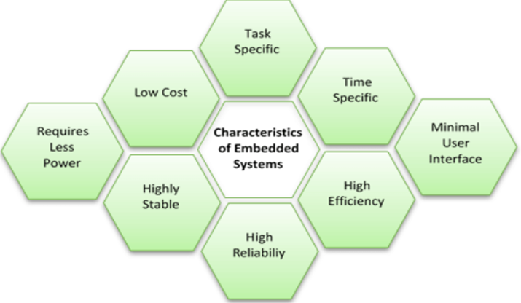
Characteristics of Embedded System
An embedded system as a Microcontroller based, software driven, reliable, real-time control system.

Slide 35
Characteristics of Embedded System
1. Requires real time performance
Ex; In a process control system, the constraint can be “If temperature exceeds 40degree centigrade, open the valve within 10 milliseconds”
2. It should have high availability and reliability.
Many embedded systems are designed for mission critical applications, defense applications etc. so high availability and reliability is required.

Slide 36
Characteristics of Embedded System
3. Developed around a real-time operating system
Software development is very fact and maintaining code is also very easy.
Non real time operating system:
Small footprint
Not suitable for hard real time systems
Ex: Embedded Linux, Embedded NT, Windows XP embedded
Used in consumer appliances such as DVD players, Set Top box etc.
Real time operating system
Used in development of hard real time systems
Ex: QNX Neutrino, VxWorks, RTLinux, MicroC/OS-II and OS/9
Mobile/Handheld operating system:
The operating system used for designing PDAs, palmtops, smartphones or handheld devices is
called as mobile operating system
Palm OS, Symbian OS, Windows CE, Embedded Linux, VxWorks, OS/9

Slide 37
Characteristics of Embedded System
4. Usually, have easy and a diskless operation, ROM boot
5. Designed for one specific task
6. Software Up gradation capability
PCO system – changes as per tariffs
7. It must be connected with peripherals to connect input and output devices.
8. Offers high reliability and stability
9. Needed minimal user interface
Less numbers of Input and output devices.
10. Limited memory, low cost, less power consumption
11. It does not need any secondary memory in computer.

Slide 38
Pros and Cons of Embedded System
Advantages
Easily Customizable
Low power consumption
Low cost
Enhanced performance
Disadvantages
High development effort
Larger time to market

Slide 39
Applications of Embedded System
Consumer Appliance
Industrial Automation
Medical Electronics
Computer Networking
Telecommunications
Wireless Technologies
Instrumentation
Security
Finance

Slide 40
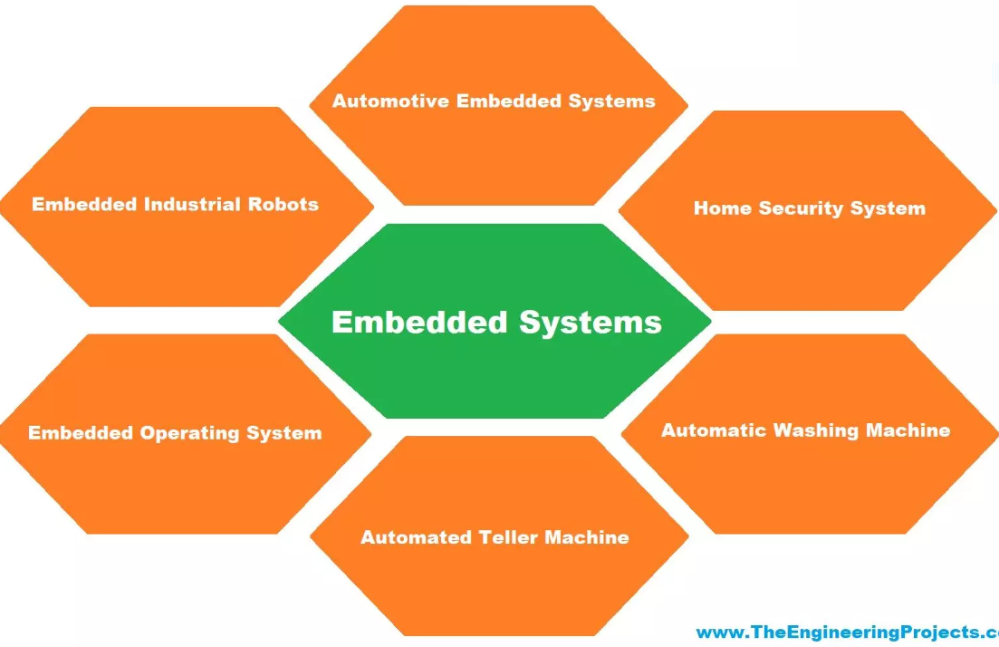
Examples of Embedded System

Slide 41
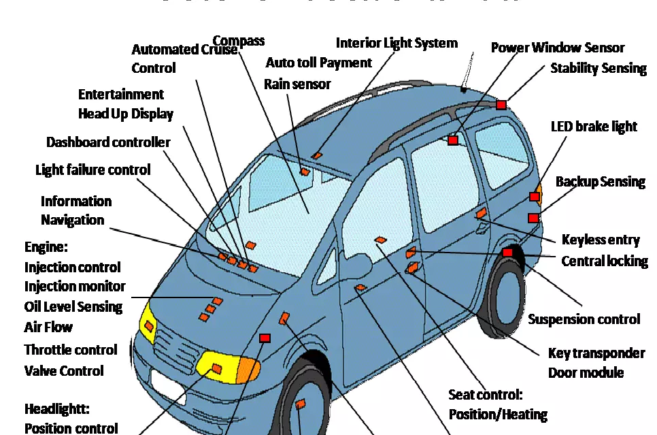
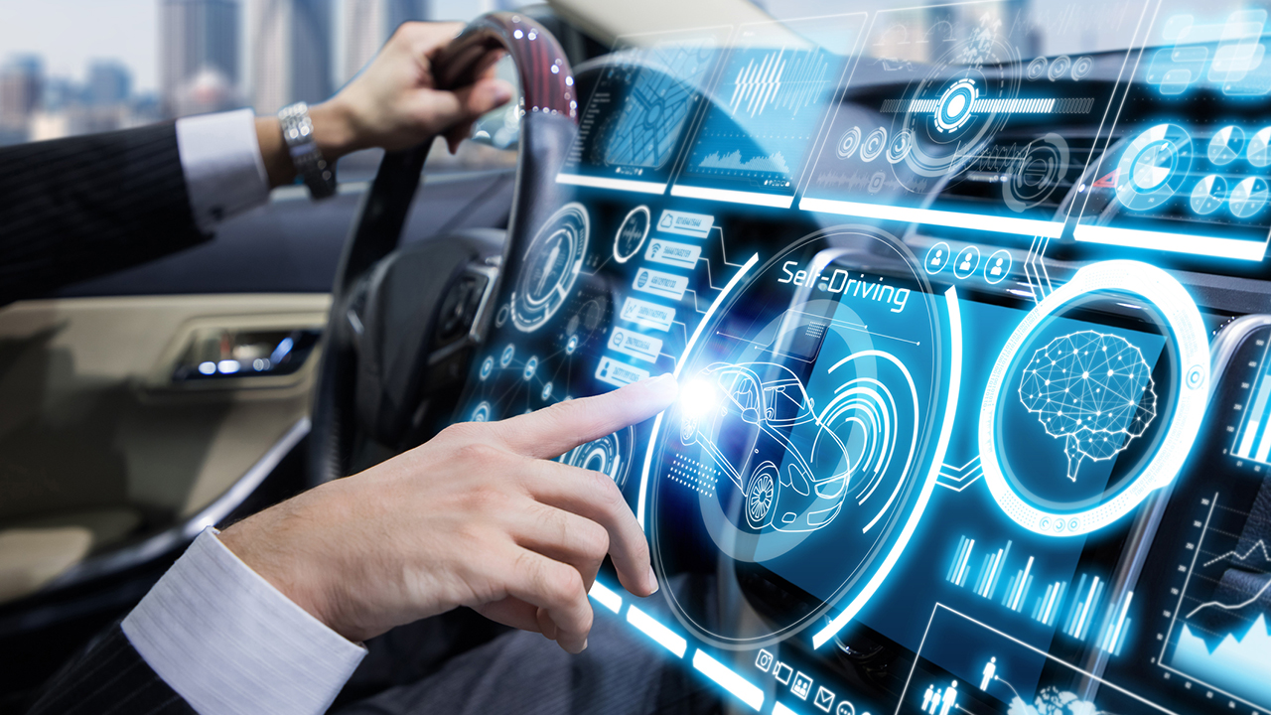
Examples of Automotive Embedded System

Slide 42
Examples of Automotive Embedded System
Today cars use embedded systems to replace old traditional systems.
Electronic Control Units are used in automotive embedded systems Examples.
This unit contains a microcontroller, switches, sensors, drivers, etc.
All the sensors and actuators are connected to the electronic control unit.
Automobiles using embedded systems may consist of hundreds of microprocessors.
Each microcontroller (Arduino, PIC- Peripheral Interface Controller Microcontroller, 8051 Microcontroller etc.) performs its own dedicated task.
Some of them control engines. Some run dashboard devices.

Slide 43
Introduction of IoT

Slide 44
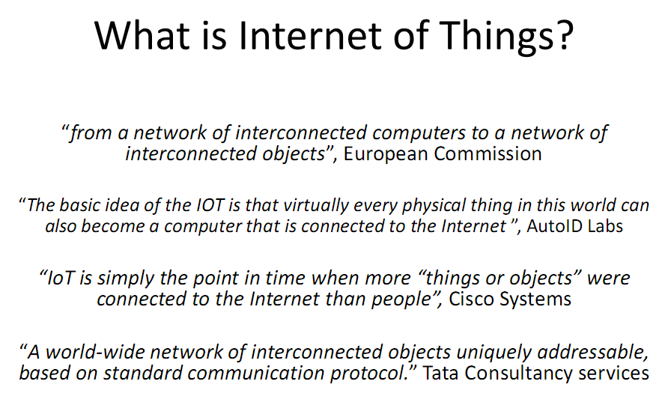

Slide 45
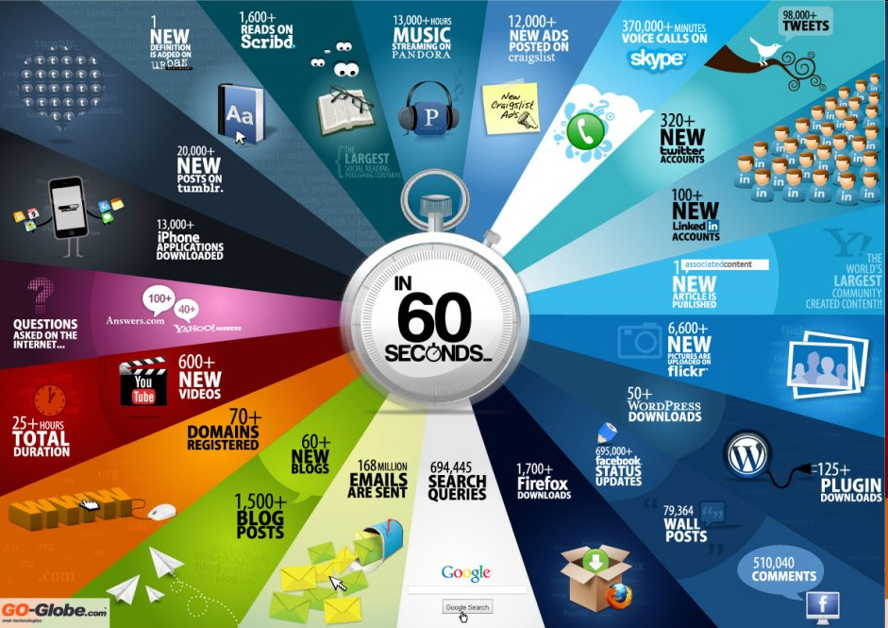

Slide 46
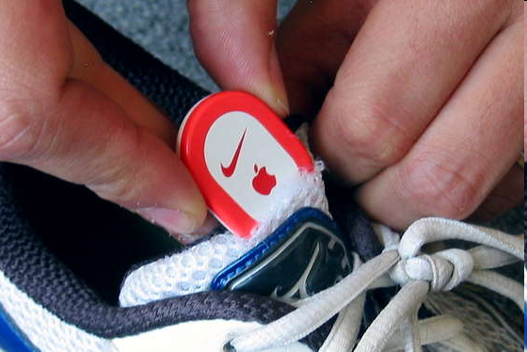
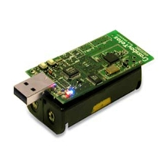
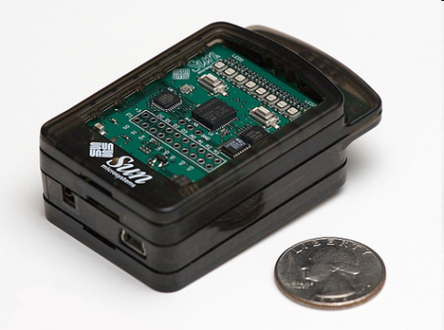
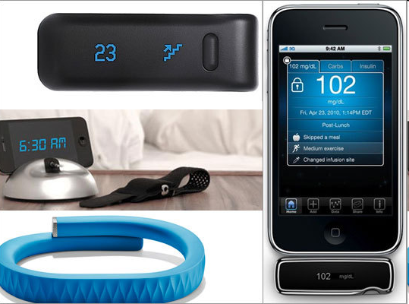
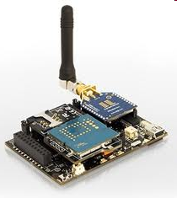
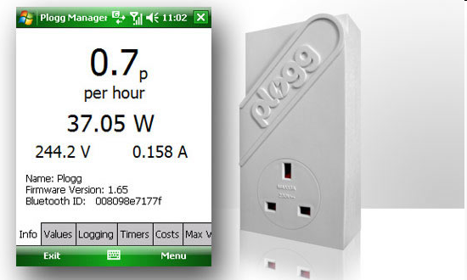
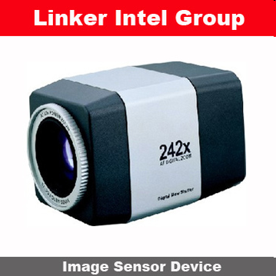
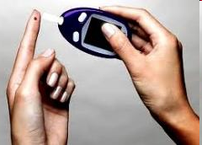
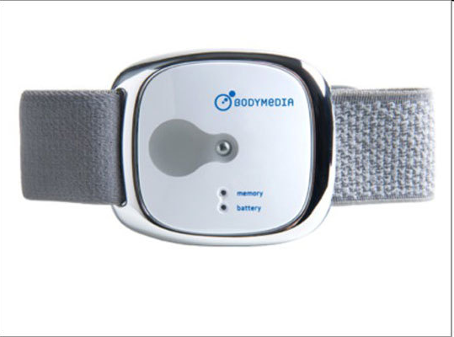
Sensor devices are becoming widely available
- Programmable devices
- Off-the-shelf gadgets/tools

Slide 47
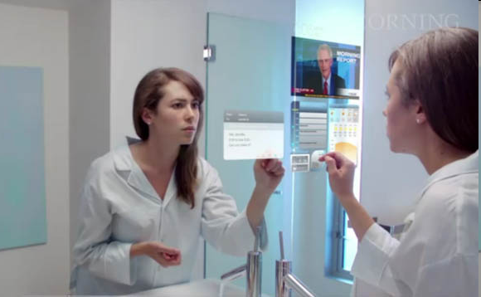
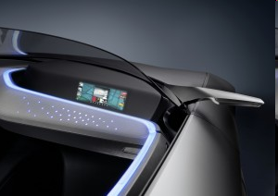
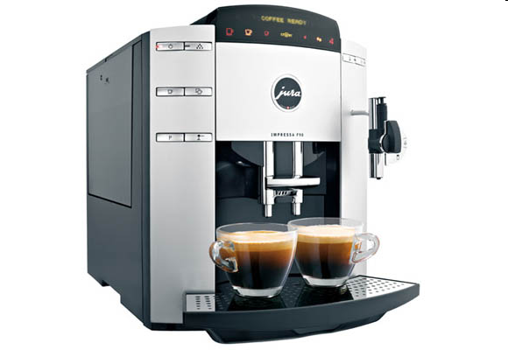
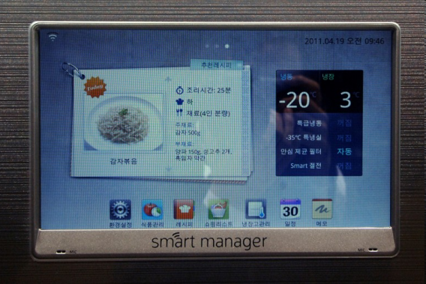
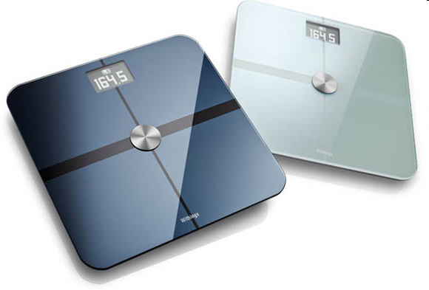
More “Things” are being connected
Home/daily-life devices
Business and
Public infrastructure
Health-care
…

Slide 48




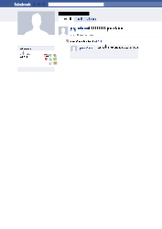
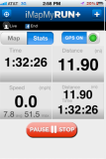
People Connecting to Things
ECG sensor
Internet
Motion sensor
Motion sensor
Motion sensor

Slide 49
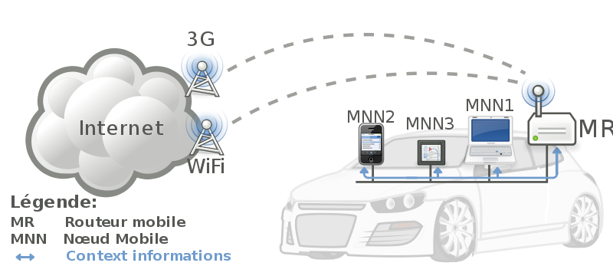
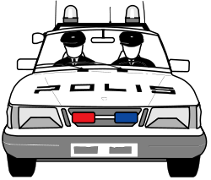

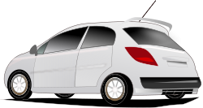
Things Connecting to Things
- Complex and heterogeneous
resources and networks

Slide 50






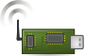
Wireless Sensor Networks (WSN)
End-user
Core network
e.g. Internet
Gateway
Sink
node
Gateway
Computer services
The networks typically run Low Power Devices
Consist of one or more sensors, could be different type of sensors (or actuators)

Slide 51
How are the networks changing?
Extensions
More nodes, more connections, IPv6, 6LowPan,...
Any TIME, Any PLACE + Any THING
M2M, IoT
Billions of interconnected devices,
Everybody connected.
Expansions
Broadband
Enhancements
Smart networks
Data-centric and content-oriented networking
Context-aware (autonomous) systems

Slide 52
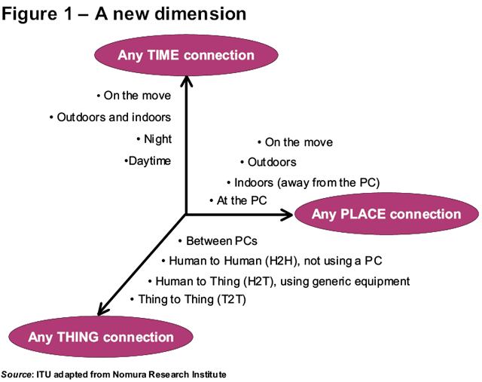
Future Networks
52
52

Slide 53
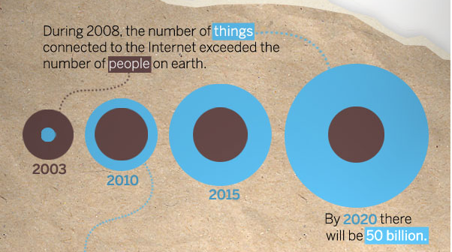
“Thing” connected to the internet
Image Courtesy: : CISCO
53

Slide 54
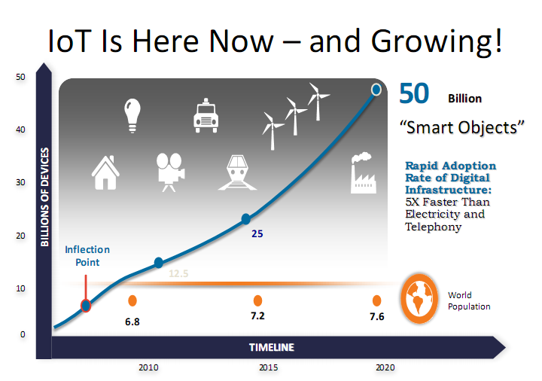

Slide 55
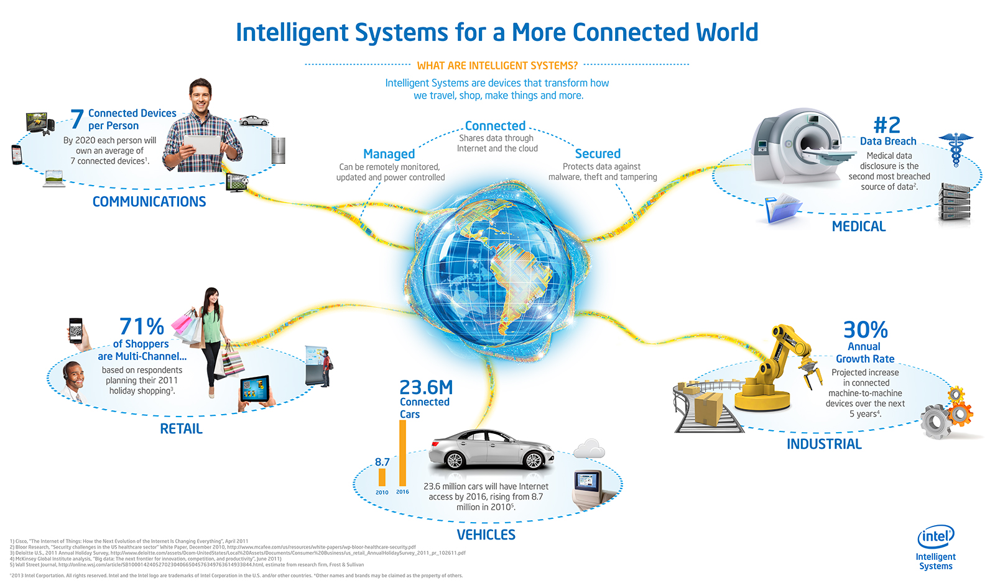
Opportunities
Source: http://blog.trentonsystems.com/internet-of-things-crosses-business-personal-boundaries/

Slide 56
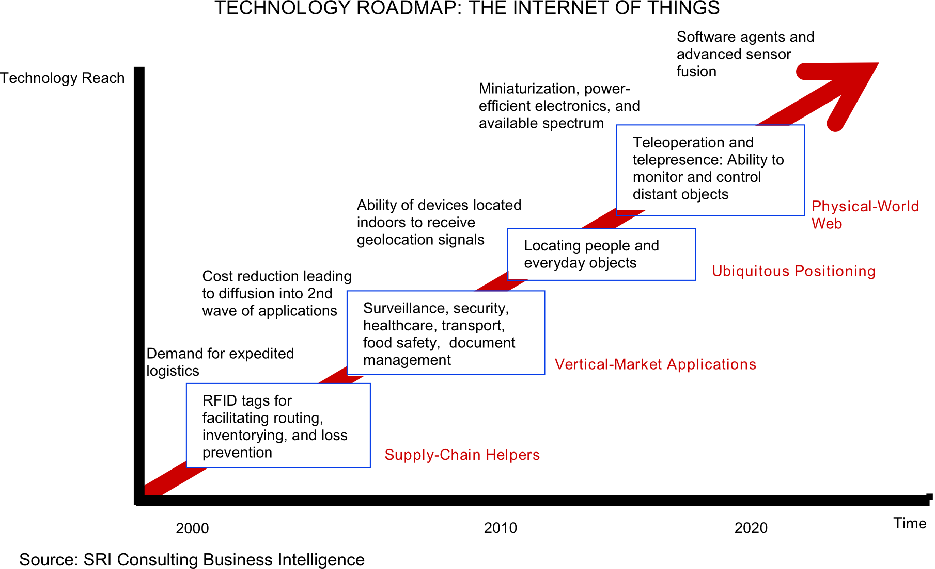
Technology trend

Slide 57
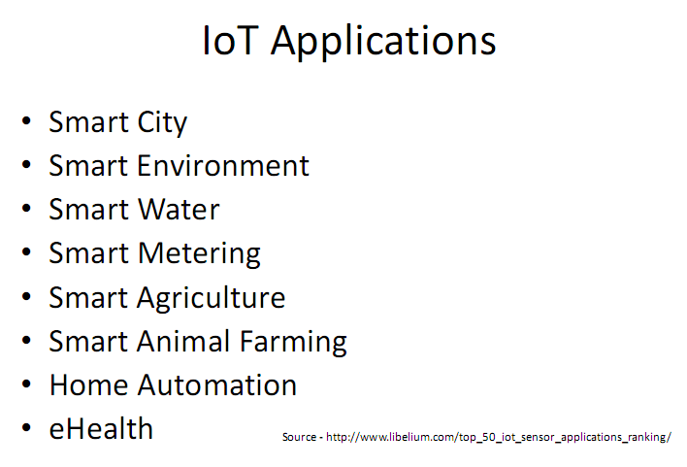

Slide 58
Applications
Setting | Description | Examples
Human | Devices attached or inside the human body | BAN, wearables and ingestibles
Home | Buildings where people live | Home controllers and security systems
Retail Environments | Spaces where consumers engage in commerce | Stores, banks, restaurants, arenas
Offices | Spaces where knowledge workers work | Energy management and security
Factories | Standardized production environments | Places with repetitive work routines, optimizing equipment use and inventory
Worksites | Custom production environments | Mining, oil and gas, construction; operating efficiencies, predictive maintenance, health and safety

Slide 59
Applications
Vehicles | Systems inside moving vehicles | condition-based maintenance, usage-based design, pre-sales analytics
Cities | Urban environments | Public spaces and infrastructure in urban settings; adaptive traffic control, smart meters, environmental monitoring, resource management
Outside | Between urban environments (and outside other settings) | Outside uses include railroad tracks, autonomous vehicles (outside urban locations), and flight navigation; real-time routing, connected navigation, shipment tracking

Slide 60
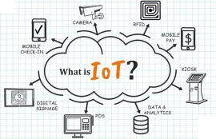
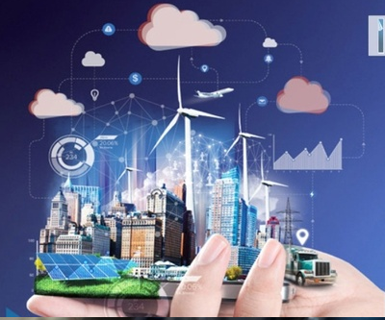
Introduction of IoT:
Definition of IoT
A dynamic global network infrastructure with self- configuring capabilities based on standard and interoperable communication protocols, where physical and virtual “things” have identities and use intelligent interfaces, seamlessly integrated into information network that communicate data with users and environments.
It is the network in which every object or thing is provided unique identifier and data is transferred through a network without any verbal communication.
Internet Of Things is Fully Networked and Connected Devices sending analytics data back to cloud or data center.
https://www.youtube.com/watch?v=GIfWNtMfYvk&t=1s
https://www.youtube.com/watch?v=Q3ur8wzzhBU

Slide 61

Characteristics of IoT:
The following are the major characteristics of the Internet of Things:
1. Connectivity: Connectivity is the ability to communicate with and share information between two or more devices. These objects can be anything from your fridge to your car, and even your dog. This connectivity enables these objects to be controlled remotely, and also allows them to exchange data with other objects.
Example: Wired LAN or Wireless technologies like Wi-Fi, LPWAN ( Low Power Wide Area Network)), LoRa (long range), ZigBee, etc…(all are communication technologies)

Slide 62
Characteristics of IoT:
cont-
2. Identity: Identity is the unique characteristic of a person, group, place, or thing. Every identity has a name and an identification number.
Example, An IP address of a device is a unique identifier that represents a device in a network.
3. Data: The IoT is made up of interconnected devices that are able to share data with each other. The data from these devices can be used to improve the performance of these devices and make them more efficient.
Example, you can now track your fitness, exercise, and sleep patterns through smart devices such as Fitbit, Apple Watch, and sleep trackers.

Slide 63
Characteristics of IoT:
4. Intelligence: The intelligence of IoT devices is the intelligence of smart sensors and devices to sense data, interact with each other and collect a huge amount of data for analysis.
5. Network – Communication: Communication is an important characteristic of IoT. There are a few ways to communicate with these devices. One way is through a cloud service, a type of software that allows the device to be connected to the internet. Another way is through a gateway which is a device that connects with other devices to allow them to communicate with each other.
6. Scalability: Scalability is often defined as the ability of a system to grow without affecting its performance. Example, if you are a hotel chain, you can use IoT to track what room your guests are in and what amenities they have used.

Slide 64

Characteristics of IoT:
7. Architecture – Common Ecosystem:
The architecture is mostly responsible for making sure that the devices work together and communicate with each other. The importance of the architecture is heterogeneous (ability to support diverse technologies, protocols, and devices.)
8. Security:
Data protection is a big concern with the internet of things because personal information can be collected and shared without consent. There are also other challenges like privacy, data ownership and hacking.

Slide 65
IoT Key Technologies

Slide 66


Slide 67


Slide 68


Slide 69


Slide 70


Slide 71


Slide 72


Slide 73


Slide 74


Slide 75


Slide 76


Slide 77


Slide 78


Technical Building blocks of IoT
BLE-Bluetooth low-energy
Z-Wave is a wireless communications protocol used primarily for residential and commercial building automation.

Slide 79

Technical Building blocks of IoT
1. Smart Thing:
Sensors
Objects (like Microcontrollers)
RFID (Radio Frequency Identification) Tags
Actuators

Slide 80


Technical Building blocks of IoT
Smart Thing: Sensors
A sensor typically measures or identifies a particular physical quantity. Sensors convert the physical properties to electrical signals understandable by machines.
Input: Physical parameter or stimuli
Example: Temperature, light, gas, pressure and sound
Output: Response to stimuli
Ultrasonic sensor- HC-SR04
Temperature and Humidity sensor – DH22

Slide 81

Technical Building blocks of IoT
Smart Thing: Smart Objects
Smart objects are those physical and digital objects which can be identified, have sensing/actuating capabilities, processing and calculating powers, also storing, and networking capabilities.
Smart objects and IoT are like two wheels of a vehicle which move together to speed up the vehicle of our modern infrastructure.

Slide 82

Technical Building blocks of IoT
Smart Thing: Non Smart Objects
Actuators : Actuators are those electronic devices which performs a specific task by collecting the information by sensors or like sensors over the internet. We can divide actuator into two parts.
Mechanic Actuators – These are those actuators which perform a task over themselves or any other object.
Actions Actuators– Actions are performed by an object. Like sending emails, vibrations.

Slide 83

Technical Building blocks of IoT

Slide 84

Technical Building blocks of IoT
Network (Connectivity)
WiFi
Blue Tooth
ZigBee
LoRa

Slide 85

Cloud based IoT Application and Storage
Health
Agriculture
Traffic
Smart City

Slide 86

Cloud based IoT Application and Storage

Slide 87
IoT Devices
IoT devices are hardware devices, such as sensors, gadgets, appliances and other machines that collect and exchange data over the Internet. They are programmed for certain applications and can be embedded into other IoT devices.
For example, an IoT device in your car can identify the traffic ahead and send out a message automatically to the person you are about to meet of your impending delay.

Slide 88

Physical design of IoT
The physical design of an IoT system is referred to as the Things/Devices and protocols that are used to build an IoT system.
All these things/Devices are called Node Devices and every device has a unique identity that performs remote sensing, actuating and monitoring work.
The protocols that are used to establish communication between the Node devices and servers over the internet.

Slide 89

Physical design of IoT
Universal Serial Bus.
Registered Jack
Serial Peripheral Bus
Secure Digital (SD) memory card
Inter-integrated-circuit
MultiMediaCard
Controller area network
Double Data Rate
Dynamic Random-Access Memory.
Secure Digital IO (SD) memory card

Slide 90
Physical design of IoT
Secure Digital (SD) memory card is one of the most popular non-volatile removable data storage media for consumer applications.
Double Data Rate
Dynamic Random-Access Memory.

Slide 91


RCA connector: company Radio Corporation of America
HDMI:--
High Definition Multimedia Interface is one of the most used audio/video interface for transmitting uncompressed video data
The RCA connector is a type of electrical connector commonly used to carry Audio and Video signals.

Slide 92
Physical design of IoT
Connectivity: Devices like USB hosts and ETHERNET are used for connectivity between the devices and the server.
Processor: A processor like a CPU and other units are used to process the data. These data are further used to improve the decision quality of an IoT system.
Audio/Video Interfaces: An interface like HDMI and RCA devices is used to record audio and videos in a system.
Input / Output interface: To give input and output signals to sensors, and actuators we use things like UART, SPI, CAN, etc.
Storage Interfaces: Things like SD, MMC, and SDIO are used to store the data generated from an IoT device. Other things like DDR and GPU are used to control the activity of an IoT system.

Slide 93

IoT Protocols:
These protocols are used to establish communication between a Node device and a Server over the internet.
It helps to send commands to an IoT device and receive data from an IoT device over the internet.
Advanced Message Queuing Protocol
Constrained Application Protocol
Message Queuing
Telemetry Transport
Extensible Messaging Presence Protocol.
Data Distribution Service

Slide 94

IoT Enabling Technologies
Different technologies together enable development of IoT applications. The IoT enabling technologies are:
Wireless Sensor Networks
Cloud Computing
Big Data Analytics
Communication Protocols
Embedded Systems
1. Wireless Sensor Networks: A Wireless Sensor Network (WSN) is a collection of devices which communicate through wireless channels. A WSN consists of distributed devices with sensors which are used to monitor the environmental and physical conditions

Slide 95

IoT enabling technologies cont-
2. Cloud Computing:
Cloud computing is a computing model in which applications and services are delivered over Internet. The resources provisioned by cloud can be compute, networking or storage.
Cloud computing offers three basic service models using which users can subscribe to cloud resources.
These service models are:
Software-As-A-Service (SAAS)
Platform-As-A-Service (PAAS)
Infrastructure-As-A-Service (IAAS)
Examples of SAAS offerings are Gmail, Facebook, DropBox, YouTube, etc.
CRM-Customer Relationship Management

Slide 96


IoT enabling technologies cont-
3. Big Data Analytics:
Big Data is a collection of data coming from various types of sources. The data is often huge which cannot be handled by the traditional databases and data warehouses.
The data analytics framework consists of six steps namely: collection, cleaning, integration, analysis, visualization and alerting.
Mission Mangal is the incredible true story behind India's mission to Mars. It shows how Rakesh Dhawan (Akshay Kumar)

Slide 97
IoT enabling technologies cont-
4. Communication Protocols
Communications protocols form the backbone for IoT systems. They allow devices to communicate with each other. Protocols define the data exchange formats, data encoding and addressing schemes for devices.
Protocols also provide flow control, error control, and other functions.
5. Embedded Systems:
Embedded system can be imagined as computing hardware with software embedded in it. An embedded system can be an independent system or it can be a part of another larger system.
An embedded system has three components. They are:
Hardware
Software
Real Time Operating system (RTOS) that supervises the application software and provide mechanism to let the processor run a process as per schedule by following a plan to control the latencies.
-

Slide 98

IoT Issues and Challenges-
Planning, Costs, Quality, Security and Privacy, Risks. Example: Smart Home /Smart Agricultural.

Slide 99



Slide 100

Difference Between Embedded System and IOT
telecommunication operator
business-to-consumer
Telcos: a company that provides telecommunications services such as fixed-line, mobile and data services for end-customers.

Slide 101


Difference Between Embedded System and IOT
A point-of-sale (POS) terminal is a hardware system for processing card payments at retail locations.
Fleet management is the management of commercial vehicle operations at scale.
An example of B2B is an oil company selling its fuel to a car dealership.
B2C e-commerce involves businesses selling products or services directly to consumers. An example of B2C is an online retail store selling clothes directly to consumers.

Slide 102

Applications of IoT

Slide 103

IoT in Smart Home

Slide 104

IoT in Smart Home

Slide 105


IoT in Agriculture

Slide 106

IoT in Agriculture

Slide 107

IoT in Agriculture

